Slide 1
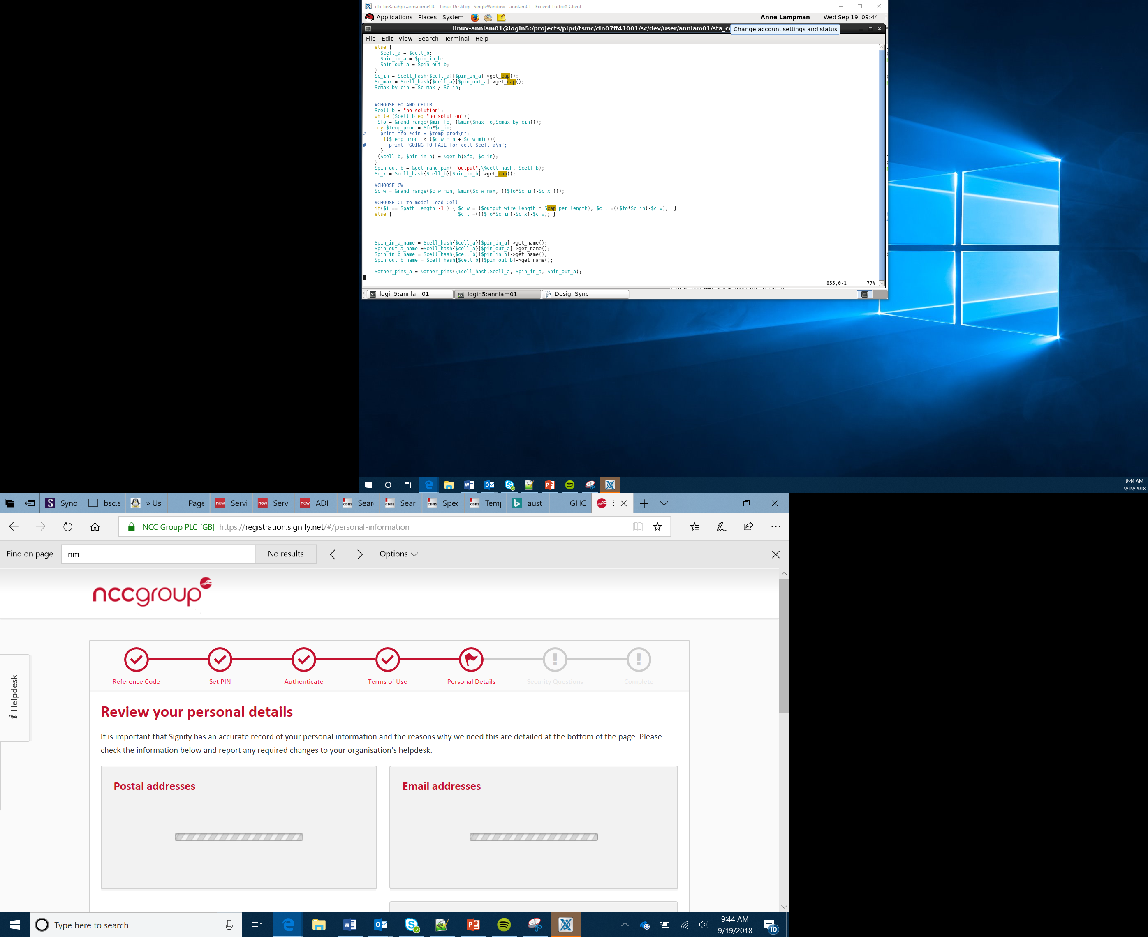

The IPO Model
Lesson 2

Slide 2
Objectives
Understand the Input, Process, Output model
Apply computational thinking to solve problems
Use algorithms to represent solutions to problems

Slide 3
What is the IPO model
Input
Process
Output
The Input Process Output model is a widely used method in system analysis and software development
The system receives an input from the user or elsewhere
The input is processed
It responds with some form of output
Notes:
Explain the concept of systems and that all systems whether computerised or not follow the basic concept of Input Process Output
You can use examples such as central heating systems, washing machines and mobile phones to get across the idea
EG
Washing machine
Input – set timer, water temp, spin cycle
Process – turns on water taps, heaters etc
Output – drum spins at right speed, the water remains at the correct temperature

Slide 4
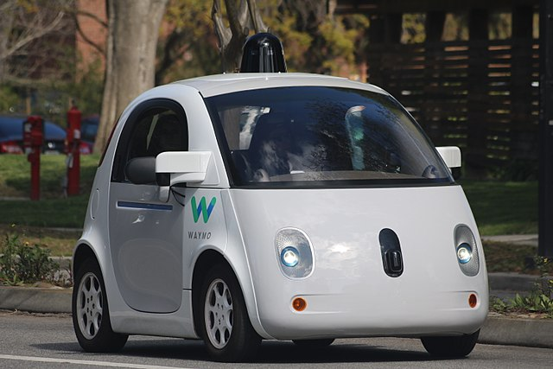
The IPO Model in Use
Imagine being in a self-driving car
Image by Grendelkhan licensed under the Creative Commons Attribution-Share Alike 4.0 International license.
A pedestrian steps in front of the car
This input has been detected by the car’s onboard sensors
It processes this information
It produces the appropriate output to apply the brakes or take evasive action

Slide 5
Computational Thinking
Abstraction
Remove the unnecessary detail to be left with just the problem
Decomposition
Break the problem down into small chunks that can be more easily solved
Notes:
Explain the concepts of computational thinking
Stick to the basics of Abstraction and Decomposition.
Explain how these can be used together. Removing the unnecessary detail from a problems and then breaking it down into manageable parts – take a look at maps of underground systems or OS maps and how these are not exact replication like satellite imagery but remove the unnecessary info to help us use the system to find our way home
This is a good time to bring up the concept of Divide and Conquer

Slide 6
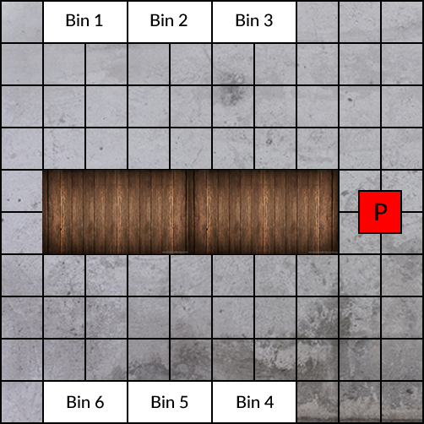
Idea Generation
You have been tasked by a major online retailer to use robotics to automate their distribution warehouse
The robot is parked in its bay (marked P)
The employees work a the desk in the centre
The robot needs to be able to automatically go to the correct storage bins, pick the required items and return them to the desk for packaging
Your robot has sensors to detect the following (Light, Line and Ultrasonic)
Think Pair Share – How could you automate the robot?
Notes:
Use the scenario to introduce the concept of I/P/O
Explain what the different sensors can do. Link the sensors to human senses
Introduce the concept of think ,pair share and get students colourably working
Get students to share their ideas so examples might be
Line followers to find the correct bin – different coloured lines for different product categories
Ultrasonic detector to identify where the walls are and stop or if a worker is in the way
Light sensor so it can identify when its in its parking zone to power down.
The Stretch Task includes Light bot which is a good website to include here http://lightbot.com/flash.html to give some idea of a robot following automated commands

